Slide 1

Topic: AI In Healthcare (Diagnosis and Treatment) Course code: INT 404 Name: Subhash Bhambu Registration no.: 12104813
Name: Atul Mahalan
Registration no : 12108213

Slide 2
AI IN HEALTHCARE
The purpose of Artificial Intelligence is to make computers more useful in solving problematic healthcare challenges and by using computers we can interpret data which is obtained by diagnosis of various chronic diseases like Alzheimer, Diabetes, Cardiovascular diseases and various types of cancers like breast cancer, colon cancer etc.
It helps in early detection of various chronic diseases which reduces economic burden and severity of disease. Various automated systems and tools like Brain-computer interfaces (BCIs), arterial spin labeling (ASL) imaging, ASL-MRI, biomarkers, IT bra,
The computer assisted diagnosis, decision support systems, expert systems and implementation of software may assist physicians to minimize the intra and inter-observer variability.

Slide 3
OBJECTIVE OF AI IN HEALTHCARE Artificial Intelligence or AI technology is gaining popularity worldwide. It is being used in big organizations as well as our daily lives. Now, taking one step forward, AI is developed to prove useful in the healthcare industry. In simple terms, all the data from diagnosis will be collected and then used for understanding the diseases, so that they can be treated with more success rate. The primary objective of an AI-based healthcare diagnosis and treatment project is to develop an intelligent system that can accurately diagnose and treat medical conditions with high precision and efficiency. The system will utilize machine learning algorithms to analyse large amounts of patient data to identify patterns, predict diagnoses, and suggest the most effective treatment plans.

Slide 4
AI in Analysis of medical images : As a result of medical examinations, huge amounts of information are created. They contain a lot of graphical data that needs to be analysed. These are MRI images, ultrasound results, cardiograms, and CT scan findings. The process of analysing and grouping medical images is time-consuming and labour-intensive. With the help of AI, the results of these graphic studies can be analysed. AI technologies optimize visual information and help cardiologists and radiologists to provide all the advantages of an automated system for recording medical documents, focus on important factors in severe cases, help to make a more accurate diagnosis, minimize the chance of errors. Algorithms analyse a lot of data at high speed and compare it with other studies of a particular patient. As a result, patterns are well traced, implicit relationships are established.

Slide 5
AI for In-Patient Mobility Monitoring : The clinical staff are busy people. Take intensive care unit (ICU) nurses, for example, who often have multiple patients in critical condition under their watch. Limited mobility and cognition during long-term treatments can adversely affect the patients’ overall recovery. Monitoring their activity is vital. To improve outcomes, researchers at Stanford University and Intermountain LDS Hospital installed depth sensors equipped with ML algorithms in patients’ rooms to keep track of their mobility. The technology accurately identified movements 87 percent of the time. Eventually, the researchers aim to provide ICU staff with notifications when patients are in trouble.

Slide 6
Digital Consultation For example , the digital health firm HealthTap developed DR A.I. and apps like Babylon in the UK use AI to give medical consultation based on personal medical history and common medical knowledge . Users reports their symptoms into the app, which uses speech recognition to compare against a database of illness and asks patients to specify symptoms to triage whether they should go to the urgent care or a primary care doctor

Slide 7
Clinical Trials for Drug Development: One of the biggest challenges in drug development is conducting successful clinical trials. As it stands now, it can take up to 15 years to bring a new – and potentially life-saving – a drug to market, according to a report published in Trends in Pharmacological Sciences. It can also cost between $1.5 and $2 billion. Around half of that time is spent in clinical trials, many of which fail. Using AI technology, however, researchers can identify the right patients to participate in the experiments. Further, they can monitor their medical responses more efficiently and accurately — saving time and money along the way.

Slide 8
Robotics-Assisted Surgery
AI can assist surgeons by providing real-time feedback during surgeries, and by helping to guide surgical instruments with greater precision. This can reduce the risk of human error and improve patient outcomes.
For example, AI can be used to guide surgical robots during minimally invasive surgeries. By analyzing data from imaging systems, such as X-rays or CT scans, AI algorithms can help the surgical robot to navigate the patient's body with greater accuracy. This can reduce the risk of complications and lead to faster recovery times for patients.

Slide 9
AI and Administrative Tasks AI is also being used to streamline administrative tasks in healthcare, such as scheduling appointments, managing electronic health records (EHRs), and processing insurance claims. This can help reduce costs and improve the efficiency of healthcare delivery. For example, AI algorithms can analyze Electronic Health Records to identify patients who are at high risk for readmission. This enables doctors to intervene early and prevent readmissions, which can be costly for both patients and healthcare providers.

Slide 10
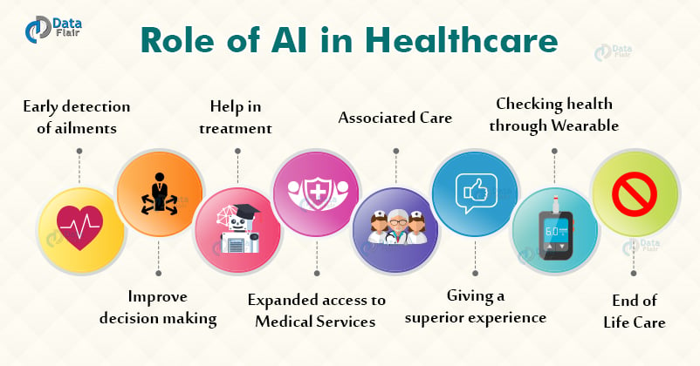

Slide 11
Disadvantages of AI in Healthcare:- Data Privacy and Security: AI algorithms rely on vast amounts of data to make predictions and recommendations. This data often includes sensitive personal health information, which raises concerns about data privacy and security. If this data is not properly protected, it could be vulnerable to cyberattacks or unauthorized access, potentially leading to identity theft or other forms of harm.

Slide 12
Cost: Implementing AI technology in healthcare can be expensive, especially for smaller healthcare organizations. The cost of acquiring and maintaining AI systems can be prohibitive, and there may also be costs associated with training staff on how to use these systems. As a result, only larger healthcare organizations may be able to afford to implement AI technology, potentially leading to disparities in access to care.

Slide 13
Limited Clinical Validation: Many AI algorithms are developed using retrospective data, which means that they may not have been tested in real-world clinical settings. This lack of validation can be problematic because it is difficult to know how an algorithm will perform in a real-world clinical setting, where patient populations and other factors may differ from the data used to train the algorithm.

Slide 14
Ethical Concerns: The use of AI in healthcare also raises ethical concerns. For example, if an AI algorithm is used to determine which patients receive certain treatments, it could be argued that this decision should be made by a human healthcare provider, who can take into account factors that may not be included in the algorithm. Additionally, there are concerns about the potential for AI to be used in ways that are discriminatory or violate patient autonomy.

Slide 15
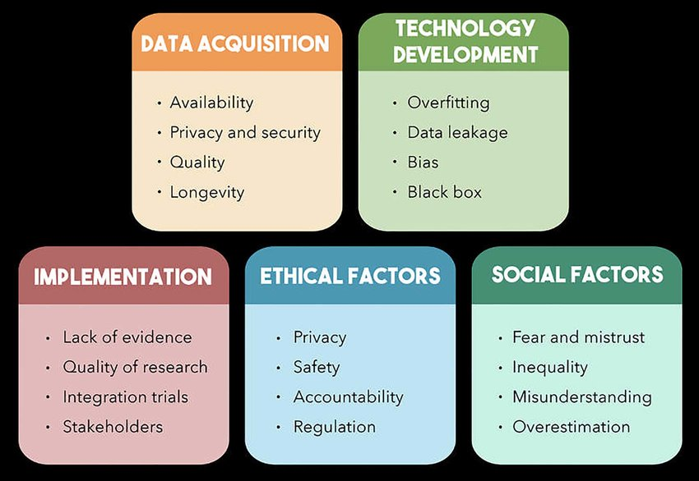

Slide 16
Conclusion:- The integration of Artificial Intelligence (AI) into healthcare has the potential to revolutionize the field and improve patient outcomes. AI has already demonstrated its value in numerous applications within the healthcare sector, including diagnostic accuracy, treatment plans, personalized medicine, and more. As the world becomes more complex and the demand for efficient and effective healthcare services increases, AI can offer new and innovative solutions to improve patient care, outcomes, and overall experience.

Slide 17


